Slide 1

Machine Learning Bootcamp Competition
Team 5 : Predicting Rig Count using Oil Price
Team Members: Dung Nguyen, Xu Yang, Charles White, Jose Benavides
Online, Sep 18, 2020

Slide 2


Objective:
The oilfield service industry is facing especially difficult times due to a decrease in demand for oil and natural gas brought on by the Covid-19 Pandemic.
Oilfield service companies seek to accurately forecast the size of the oil market in the coming months by predicting rig count.
The rig count represents the number of active rigs that are in operation and are the possible customers of oilfield services companies.
This project will forecast the future rig count and give service providers a reference point to predict the prospective market.

Slide 3
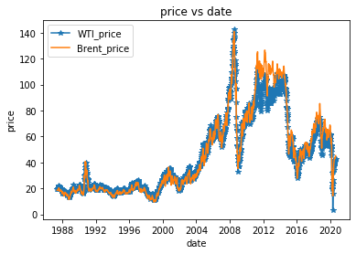
Initial Data Set

Slide 4
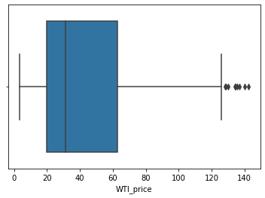
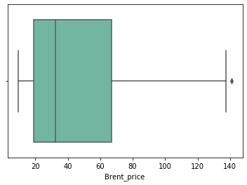
Box Plots Raw Data
Rig count

Slide 5
Box Plots Clean Data

Slide 6
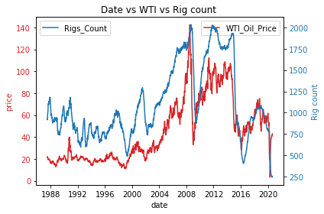
Processed Data

Slide 7
Data set:
This model will be created using historical rig counts, West Texas Intermediate spot prices and Brent Crude oil spot prices.
Our data set will encompass monthly averages from June 1st of 2010 to June 30th of 2020.

Slide 8
Lag in Rig Count:
Because most service companies execute wellsite activities on a contract, there is a lag between a drop in the spot price and a drop in the rig count. An operator may want to shut down an operation but will be contractually obligated to continue the project until the contract in concluded.
In order to calculate this lag, past rig count and spot prices were placed on a liner graph and R^2 values were evaluated to determine how many months the rig count lagged behind the spot price.
The lag that gave the most accurate results was 3 months the spot price of both WTI and Brent crude.

Slide 9
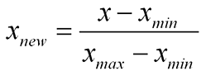
Normalizing:
Once an accurate lag is established for all variables, all independent values need to be normalized. Normalizing the data set causes all independent variables to have a uniform effect on the dependent variable.
This graph shows the final results of the linear correlation. As can be seen, This gives a final R^2 value of .908 which is allows us to make accurate future predictions.

Slide 10
Final Results of Linear Calculations:
Once the linear model is created, an equation can be established that will allow accurate rig count forecast to be generated on a monthly basis.
Because this model has a built-in lag time of three months, the predictions that it makes are for three months in the future. This give service companies an adequate amount of time to make the necessary adjustments that will allow them to meet the future market demands of oil and gas operators.
The final equation is as follows:
$Future Rig Count=1822.4(\frac{{WIT}_{Normalized}}{2}+\frac{{Brent}_{Normalized}}{2})$+344.01

Slide 11
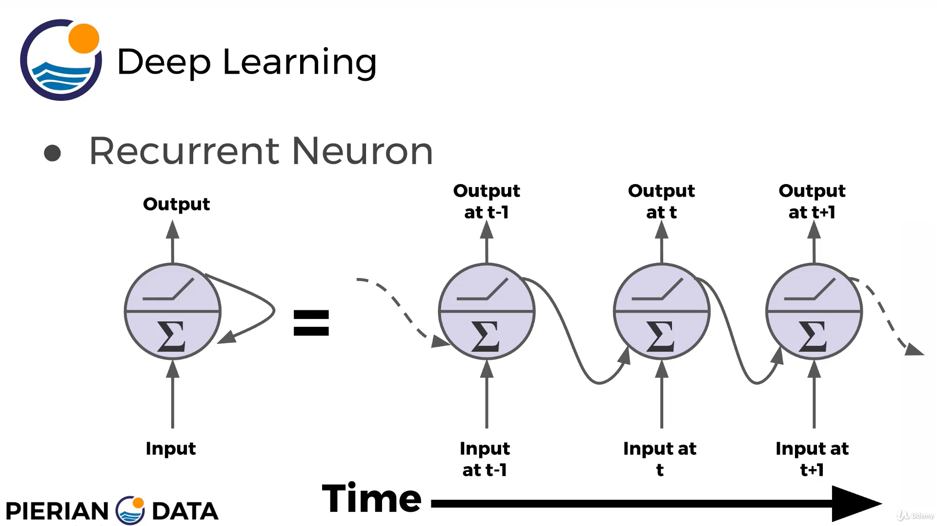
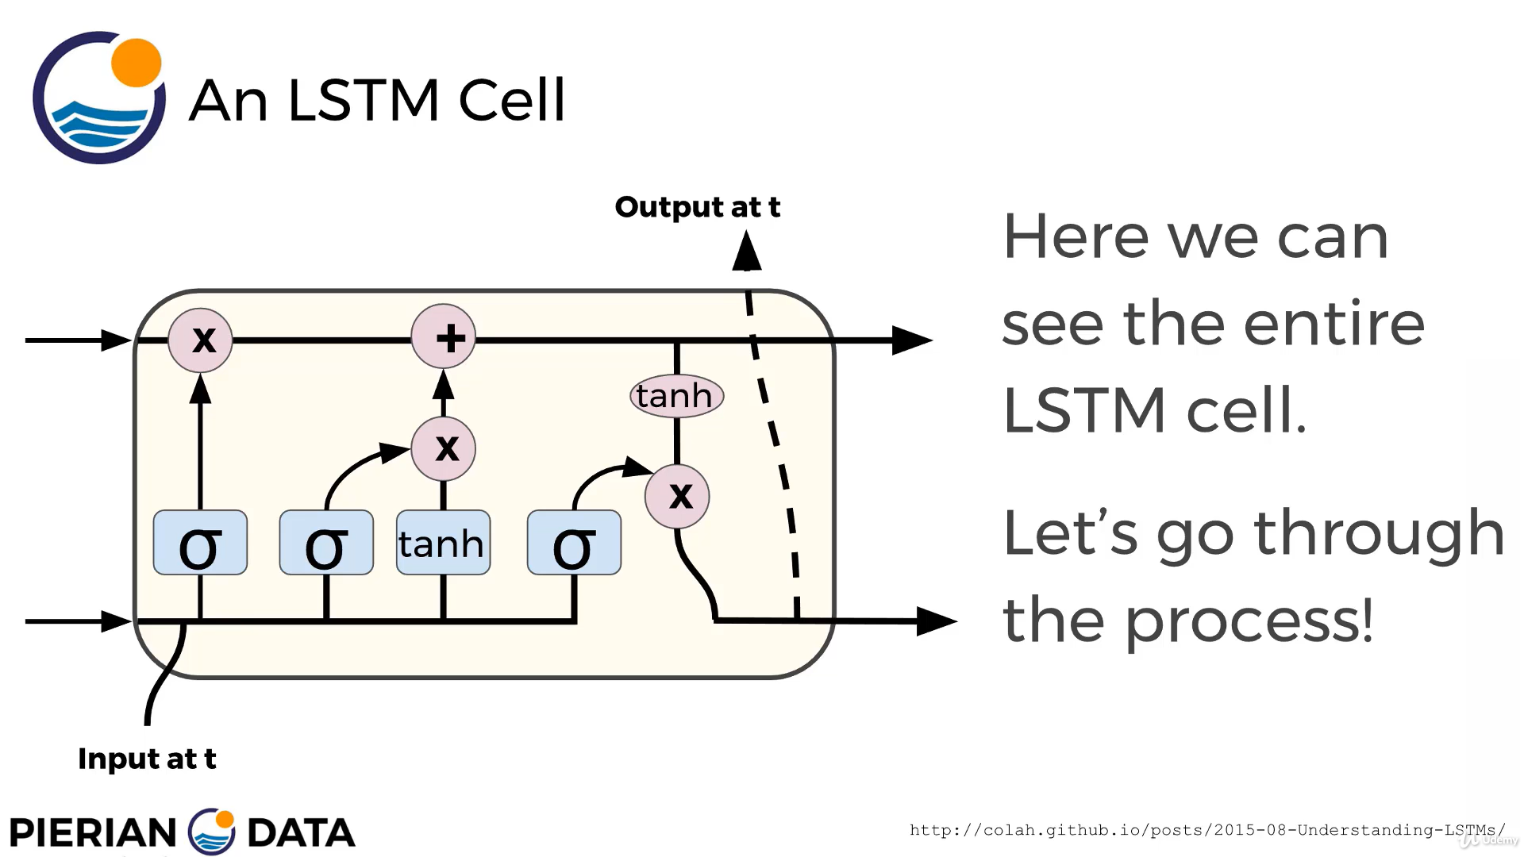
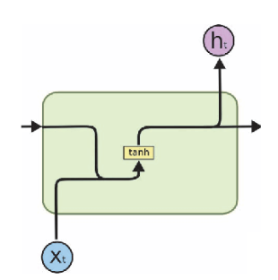
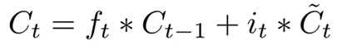
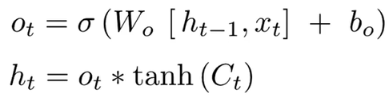
Recurrent Neural Network (SimpleRNN and LSTM)
Recurrent Neural Network
Forgetting
gate
Storing
gate
Output
Ct
ht-1
ht
xt
xt
Remembering older inputs while
dynamically updating the weights more recently!
Notes:
And since it is a time series problem which the actual rig counts is a reflection of previous rig counts and oil prices, we decided to try out Recurrent Neural Network to see if we could get a more reliable time sequence prediction. So, in RNN, each perceptron takes the input both from the current timestamp and previous timestamp. However, by implementing the simple RNN with a traditional memory cell like this, we found that our prediction accuracy were pretty low. Actually an issue RNN face is that after a while the network will begin to “forget” the first inputs as information is lost at each step going through the RNN.
In order to perform a robust method which takes a relatively long-term memory, we changed this perceptron to another kind LSTM here.
So in addition to the xt and ht-1 we also have a cell state and by passing the information into the cell which includes the forget gate, storing gate and output section, we end up passing the updated cell state as well as the output of the cell to the next neuron.
So this kind of architecture actually worked pretty well, and I would like to introduce my teammate Yong to share our modelling results.

Slide 12
Conclusion
CONTENTS

Slide 13
Thank you for your time!
Special thanks is due to :
UH SPE for putting together this bootcamp
Huy Tran for being our mentor
And last but certainly not least to Naveen Krishnaraj for taking the time to make all of this possible

